Slide 1
EmployeeDataAnalysisusingExcel
STUDENT NAME: B.KANIMOZHI
REGISTERNO : 312210559
DEPARTMENT :B.COM(AccountingandFinance).
COLLEGE :SRMArtsAndScienceCollege.
1

Slide 2
PROJECTTITLE
EmployeeData SetAnalysis usingExcel
2

Slide 3


AGENDA
1.ProblemStatement 2.ProjectOverview
EndUsers
Our Solution and Proposition
Dataset Description 6.Modelling Approach
7.Results and Discussion 8.Conclusion
3/21/2024 AnnualReview
3

Slide 4

PROBLEMSTATEMENT
To analyze the employee data set to identify key trends, patterns, and areas for improvement within the organization. This will help in making data-driven decisions related to workforce management, employee performance, and overall organizational efficiency.
4

Slide 5

PROJECTOVERVIEW
This overview provides a structured approach to the project, detailing the objectives, methodology, and expected outcomes. Adjust the details based on your specific project requirements and available data.
5

Slide 6


WHOARETHEENDUSERS?
HR Managers: To develop targeted employee engagement initiatives and improve HR policies.
Senior Management: To guide strategic decisions and evaluate overall organizational performance.
Line Managers: To improve team performance and manage day- to-day operational challenges.
6

Slide 7

OURSOLUTIONANDITSVALUEPROPOSITION
ConditionalFormatting:
Tohighlightsthemissingvalue ofthe data.
Filter:
Toremovethemissingvalueofthe data.
Formula:
To find the employees performance level inthe data.
PivotTable:
Tosummarytheemployeesdata.
Graph:
Tovisualizationoftheemployeesdatainthe organisation.
7

Slide 8
Dataset Description
Name: Full name of the employee
Department: The department where the employee works
Age: The age of the employee.
Gender: The gender of the employee (e.g., Male, Female, Non- Binary)
Salary/Compensation: The employee’s base salary or total
compensation package.
Empolyee Status: Employment status (e.g., Full-Time, Part-Time, Contract)

Slide 9

THE"WOW"INOURSOLUTION
Performance level:=SUMIF(D2:D100, "Training", E2:E100)
3/21/2024 AnnualReview
9

Slide 10
MODELLING
Identify what you want to achieve with your modeling. Common objectives might include:
Predicting employee turnover.
Analyzing the impact of training on performance.
Assessing factors influencing compensation.
10

Slide 11
Data Cleaning:
Conditional Formatting:
To highlights the missing value of the data.
Filter:
To remove the missing value of the data.
Performance level:
=SUMIF(D2:D100, "Training", E2:E100)
Summary:
Pivot Table:
To summary the employees data.
Graph:
To visualization of the employees data in the organisation.

Slide 12
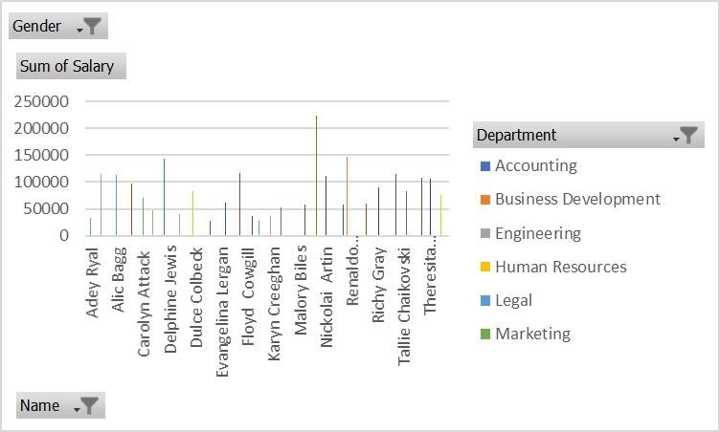
RESULTS

Slide 13
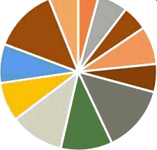

Accounting
Gender
SUFFI Df Salary
Name
Fred Dudeney Jen esy O'Fer ris Jill Shipsey
Joaquin McVitty s Kath Bletsoe
Department •

Slide 14
Conclusion
1
After performing a comprehensive analysis of the employee data set using Excel, several key insights
and conclusions can be drawn. This section summarizes the findings, implications, and recommendations based on the modeling and analysis conducted.

